Slide 1
Welcome!
We are so glad you are here!
August 2023

Slide 2
Jared Mead, Snohomish County Councilmember, District 4
Representative from the Planning and Development Services Office
Snohomish County Sheriff

Slide 3
Upcoming Meetings
June 17 (Horseshoe Grange)
WSDOT Deep Dive
August 12 (View Church)
Community BBQ
Snohomish County Sheriff
Fire Department
Michael Ervick
September 23 (Horseshoe Grange)
Townhall
Representative April Berg
Representative Brandy Donaghy
Senator John Lovick

Slide 4
Why Are We Here Tonight
Hanger 420 is violating the 10,000 ft rule per County Code 30.28.120
Ignoring violation could invite future willful code violations in Clearview's Rural Commercial zone leading to additional marijuana shops and dispensaries
Will cover WHY Hanger 420 is allowed to violate the 10,000 ft rule on following slides.

Slide 5
Snohomish County Code (SCC):
Comprehensive collection of all the permanent laws and regulations that govern various aspects of life in Snohomish County. It includes rules on topics such as zoning, public safety, health, and business regulations
The SCC is continuously updated as new ordinances are passed and incorporated into the code.
Snohomish County Ordinances:
Specific legislative acts passed by the Snohomish County Council. Ordinances can create new laws, amend existing laws, or repeal old ones. Once an ordinance is passed and becomes effective, it is codified into the Snohomish County Code.

Slide 6
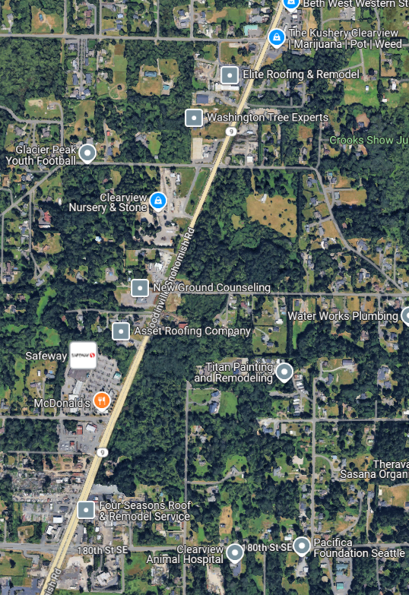
164th Street SE
The Kushery
County Code Timeline:
2012: recreational marijuana use legalized in Washington State
2012-2016: marijuana shops and medical marijuana dispensaries proliferated along Highway 9
2023: Clearview Community Association helped pass rules controlling the spacing of marijuana shops in our Rural Commercial area, as well as other rural areas in the county.
Passed as County Code 30.28.120.
Code:
Requires a minimum of 10,000 feet between marijuana dispensaries
Violation:
Hangar 420 moving into prior Kushery location. This second shop is 1 mile (5,280 feet) from the Kushery.
180th Street SE
Hanger 420

Slide 7
What is Ordinance 23‑009?
Snohomish County Code (SCC):
Comprehensive collection of all the permanent laws and regulations that govern various aspects of life in Snohomish County. It includes rules on topics such as zoning, public safety, health, and business regulations
The SCC is continuously updated as new ordinances are passed and incorporated into the code.
County Code 30.28.120
Snohomish County Ordinances:
Specific legislative acts passed by the Snohomish County Council. Ordinances can create new laws, amend existing laws, or repeal old ones. Once an ordinance is passed and becomes effective, it is codified into the Snohomish County Code.
Ordinance 23‑009
Snohomish County Ordinance 23-009 pertains to the regulation of marijuana retail. Under this ordinance, marijuana retail is now a permitted use in all zones where it is allowed, including the Urban Center (UC) zone1. This change is reflected in the Urban Zone Categories Use Matrix in the Snohomish County Code (SCC) 30.22.100
What does this mean?
In simple terms, Snohomish County Ordinance 23-009 allows marijuana retail stores to operate in more areas within the county. Specifically, it means that these stores can now be set up in all zones where they are permitted, including urban centers. This change makes it easier for marijuana retailers to find suitable locations to open their businesses.

Slide 8
Timeline of Ordinance 23‑009
2013: Snohomish County passes first land use regs
2012-2015: Marijuana shops and medical marijuana dispensaries proliferated along Highway 9
2015: Ordinance 15-009 passed by SCC removing MR as a permitted use in CRC Zoning
2017: Amended Ordinance 17-006 passed making MR(marijuana retail) a conditional use.
Conditional use requires a hearing examiner rather than straight through PDS. Project applicants must demonstrate:
Consistent with county comprehensive plan
Comply with Title 30 SCC
Not be materially detrimental to nearby existing uses
Be compatible with site and surrounding uses
2016-2022: This area of regulation (CRC and Marijuana retail in rural Snoho county) being managed by rules and piece- meal changes to code by emergency meeting.
2022: Motion 22-337 introduced by Councilmember Mead to modify MR regulations. Sets the initial framework for updating marijuana retail regulations.
2023: Ordinance 23-009 passed codifying previous rules and 10,000 foot restriction between operating MR businesses in CRC
February 2, 2023: Ordinance File Create Builds on Motion 22‑337’s proposals; formally introduces Ordinance 23‑009.
February 7, 2023: Committee Review & Assignment Planning & Community Development Committee reviews; moves the proposal to administrative matters.
February 8, 2023: Public Hearing Scheduled During the General Legislative Session, the public hearing date for Ordinance 23‑009 is set.
March 8, 2023: Public Hearing & Approval Council holds the public hearing and votes to approve Ordinance 23‑009.

Slide 9
Thank you for coming!
Please join us at our next meeting at 7pm, June 17@ Horseshoe Grange
WSDOT deep dive

